Slide 1
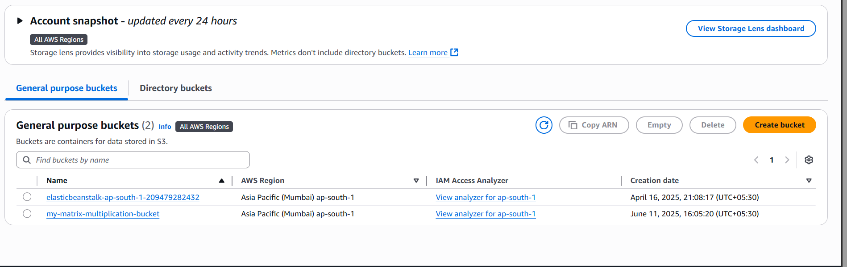
Notes:
Create s3 bucket

Slide 2
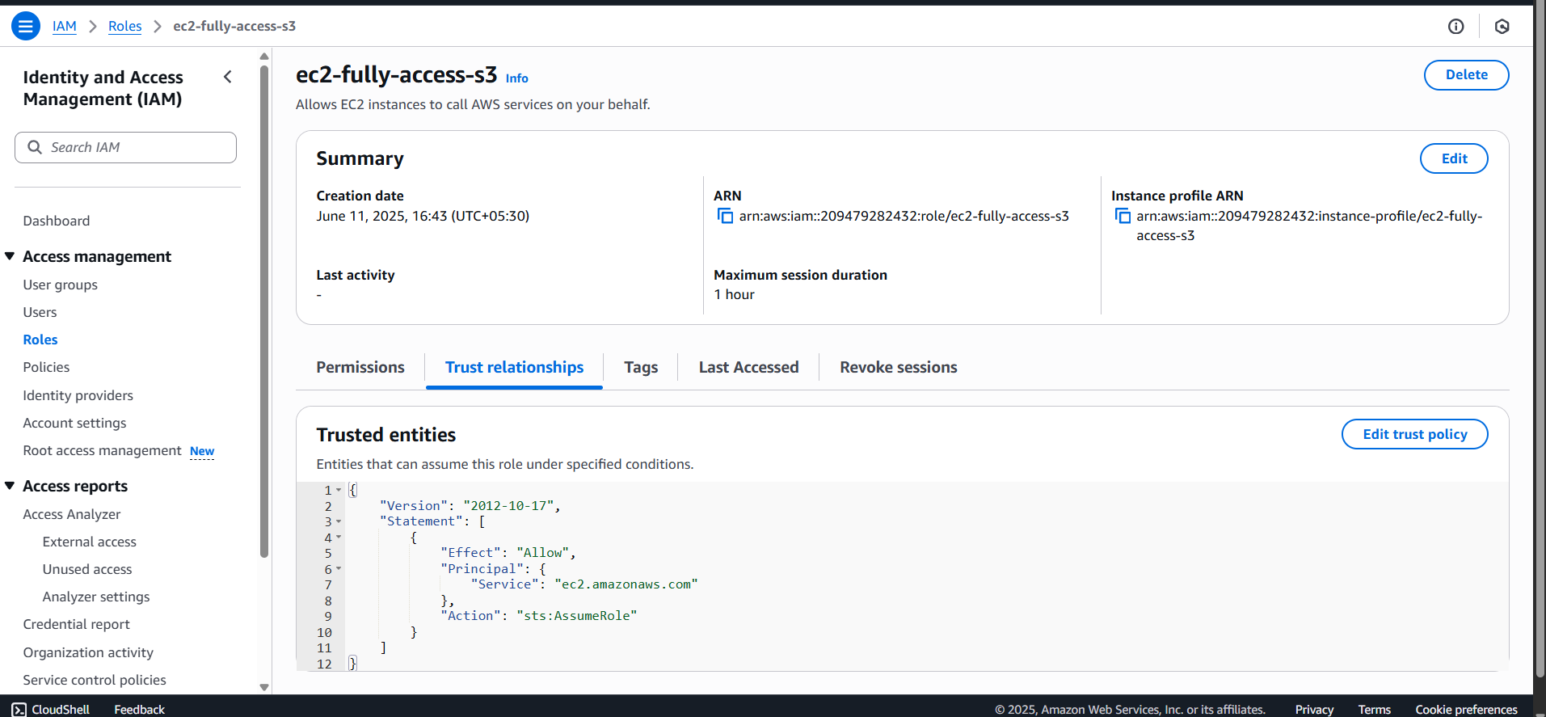
Notes:
Ec2 access s3

Slide 3
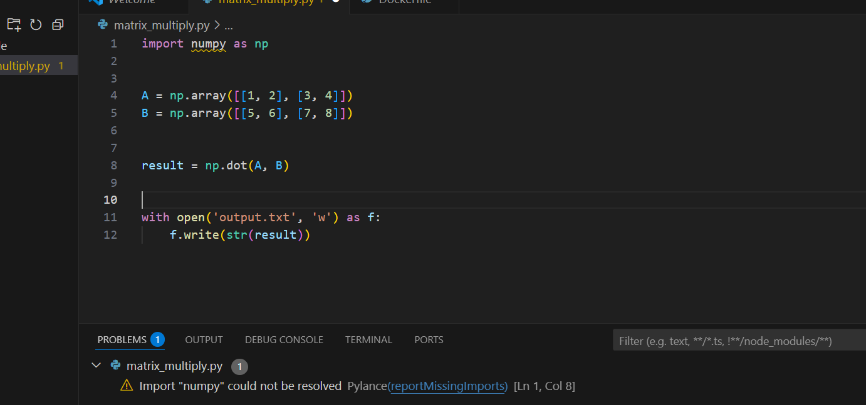
Notes:
Matrix code

Slide 4
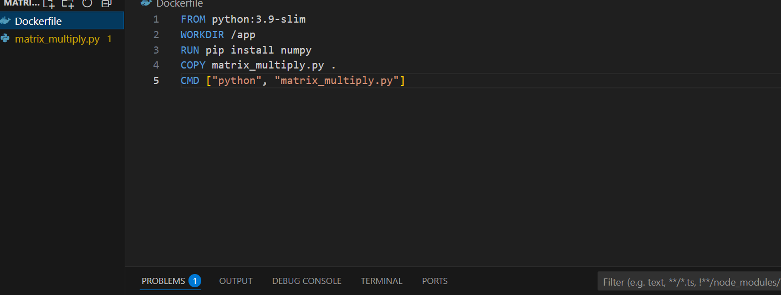
Notes:
Docker file

Slide 5
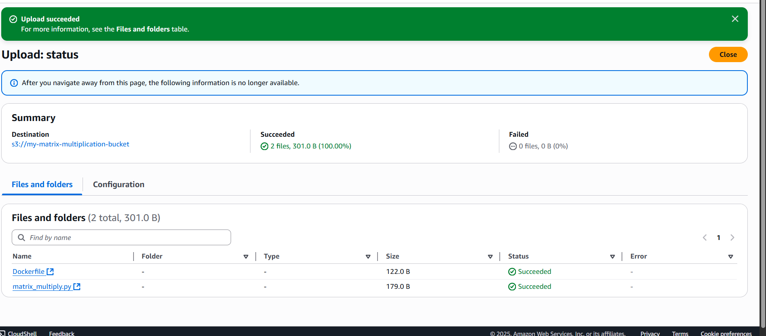
Notes:
Upload both file in s3 bucket

Slide 6
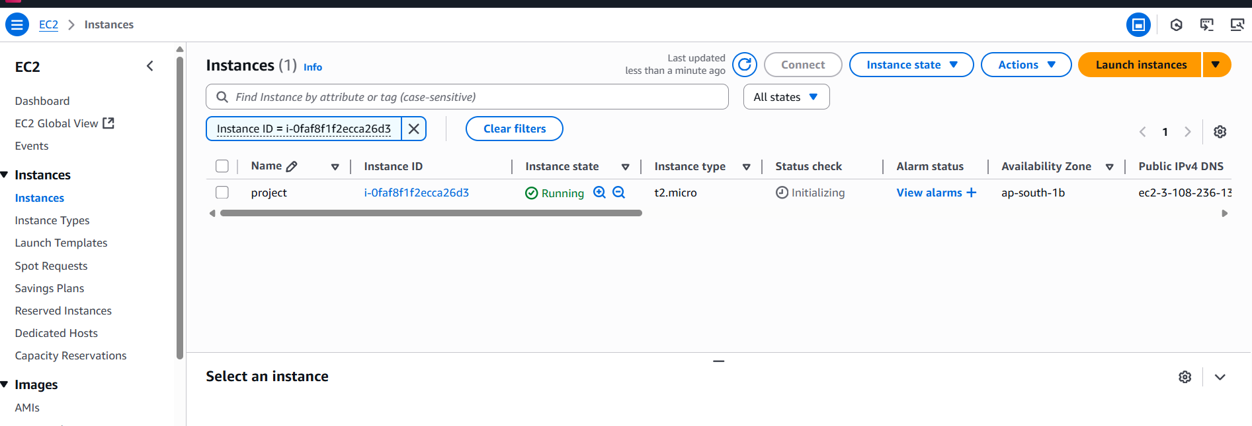
Notes:
Create ec2 instance and create new security group only allow ssh traffic port 22

Slide 7
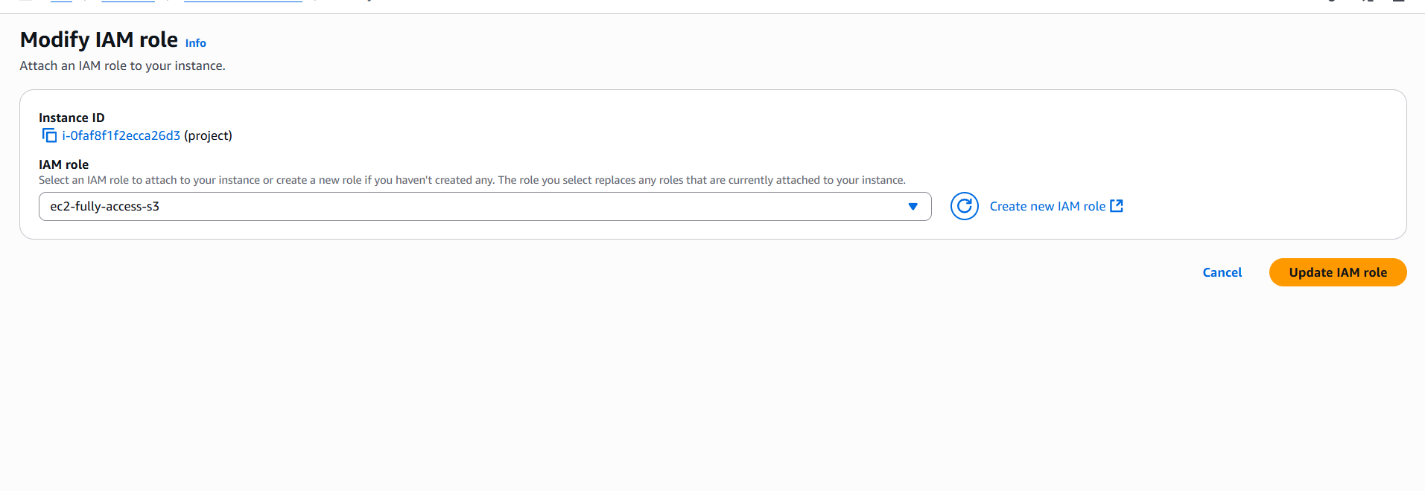
Notes:
Add iam rule s3 fuuly access

Slide 8
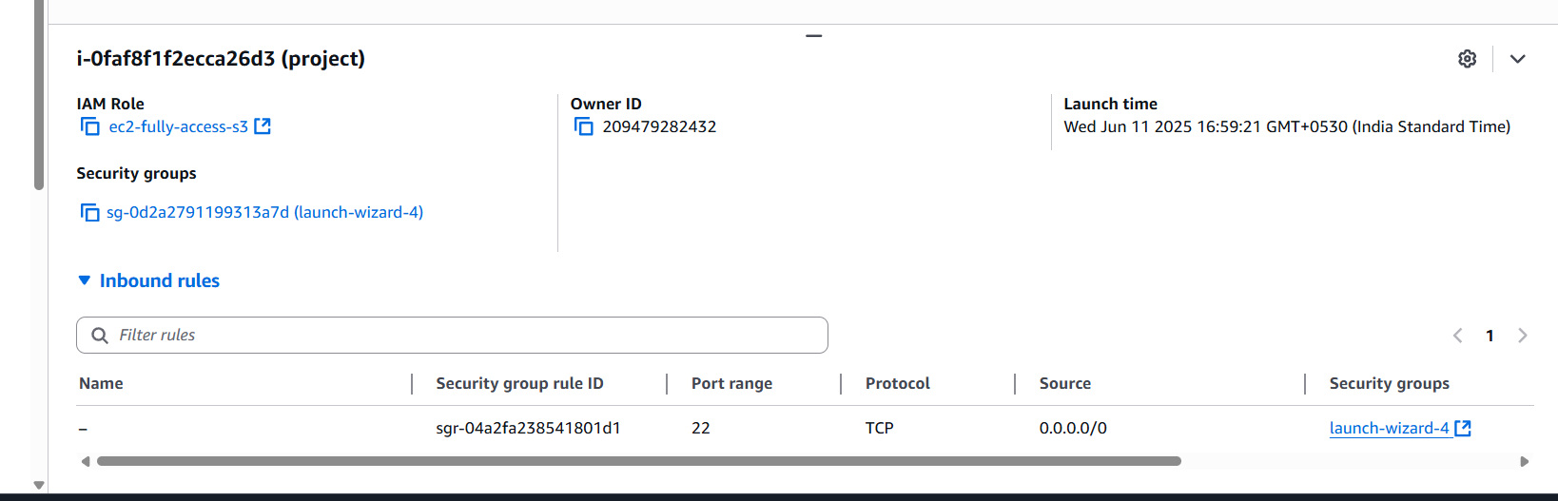

Slide 9
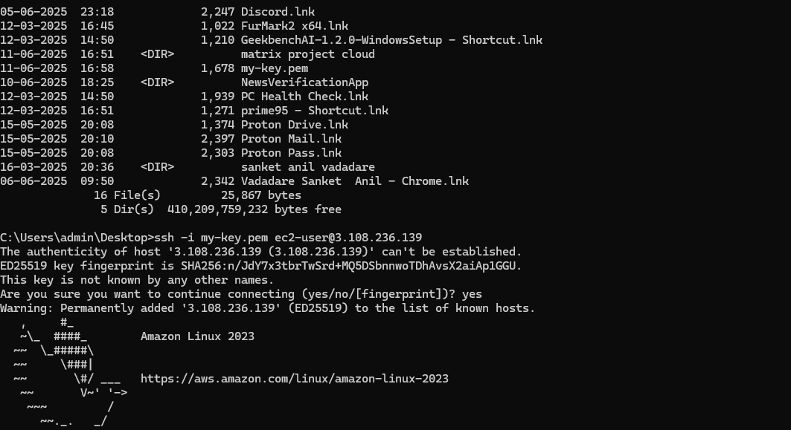
Notes:
Access ec2 in cmd

Slide 10
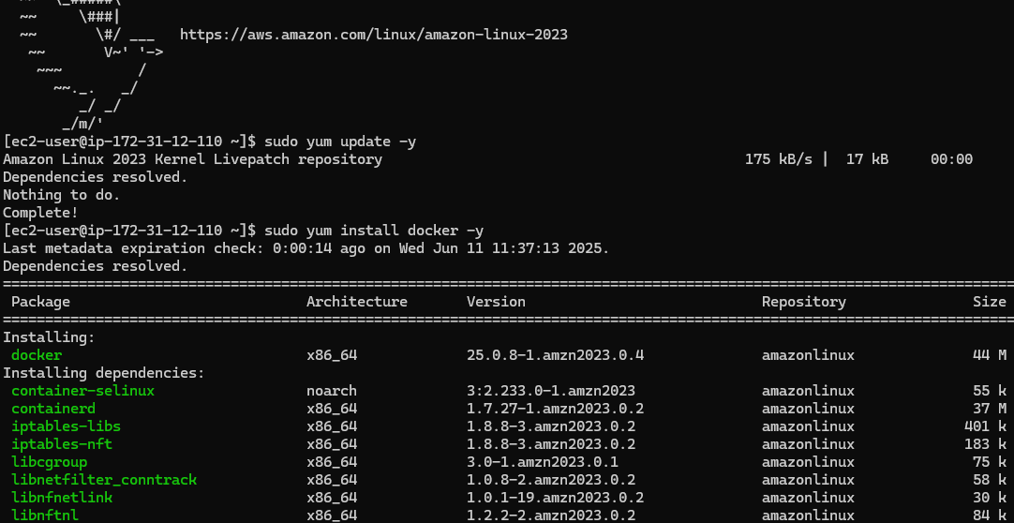
Notes:
Install docker in instance

Slide 11
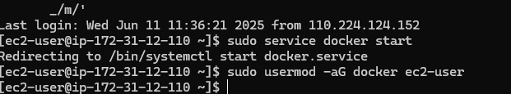

Slide 12
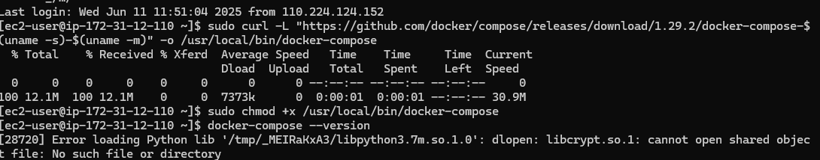
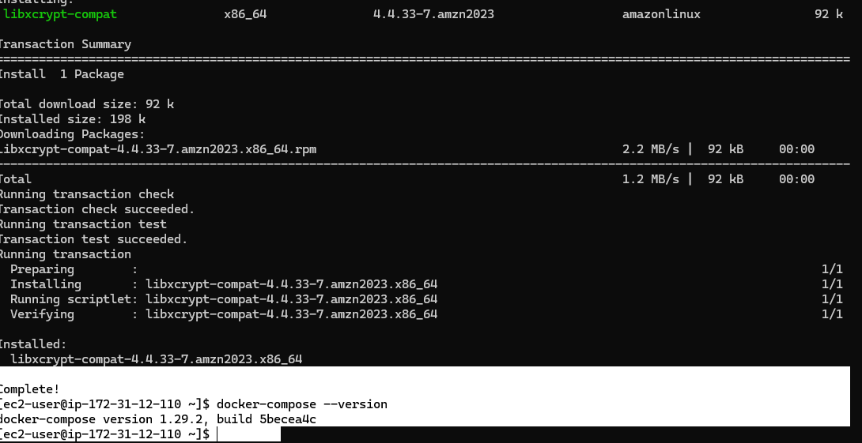

Slide 13
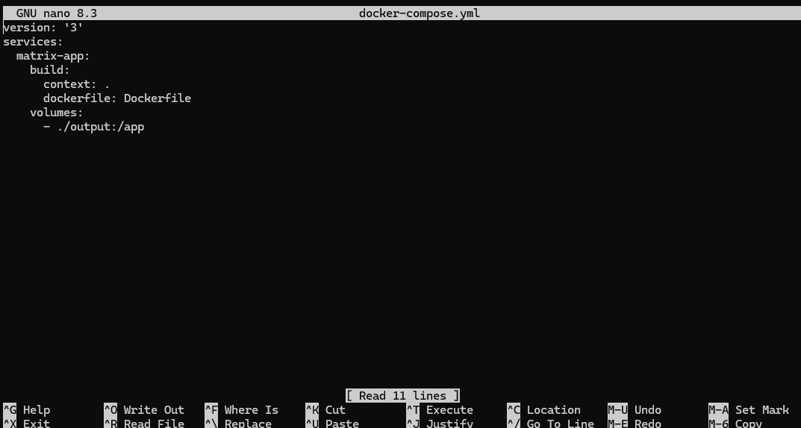
Notes:
Create file docker compose

Slide 14
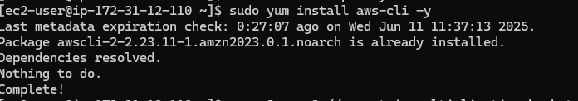
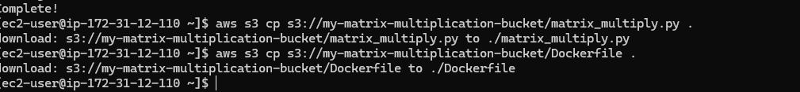
Notes:
Download s3 bucket file

Slide 15
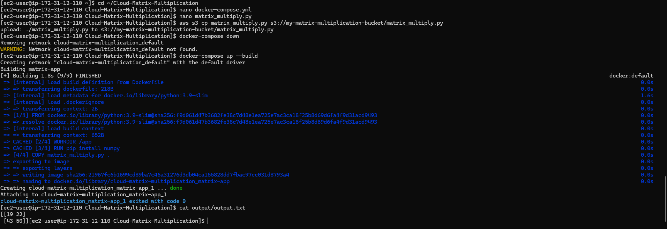
Notes:
Output save in s3 bucket

Slide 16
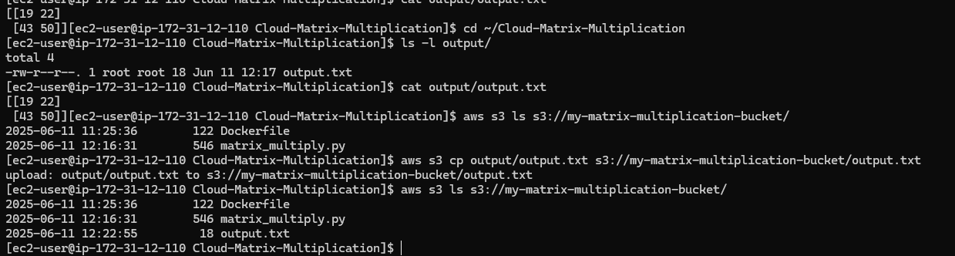
Notes:
Output file upload in s3 bucket

Slide 17
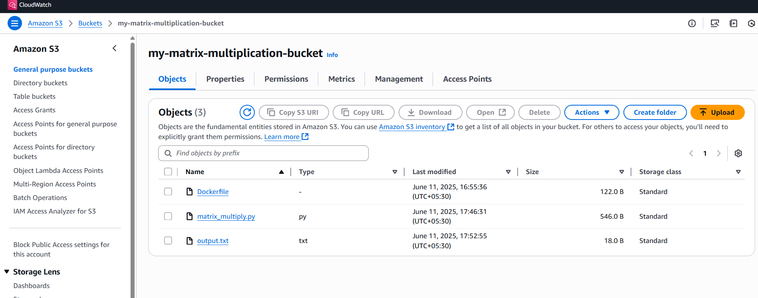

Slide 18
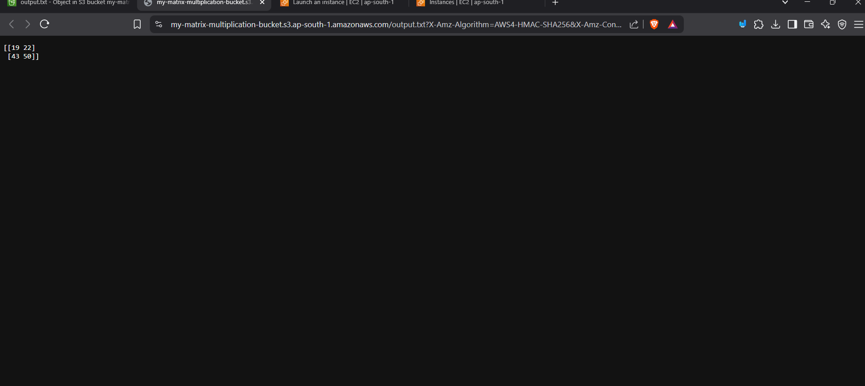

Slide 19
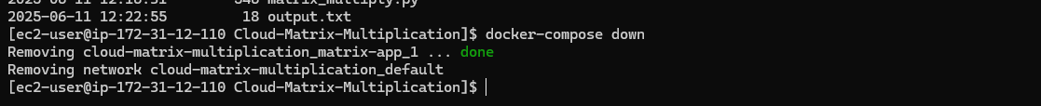
Notes:
Destroy container

